Slide 1

Classes & Objects in Java

Slide 2
Class in Java
A class is a user-defined data type.
A Class is collection of members like Attributes(Variables) & Methods(Functions)
It is a template or blueprint from which objects are created.
A class in java can contain:
  data members(variables) & methods
  constructors
  block
  class and interface

Slide 3
Object in Java
An entity that has state and behavior is known as an object. e.g. chair, bike, marker, pen,
It can be physical or logical (touchable or non-touchable)
The example of logical object is banking system.
An object has three characteristics:
  state: represents data (value) of an object.
  behavior: represents the behavior (functionality) of an object such as deposit, withdraw etc.
  identity: Object identity is typically implemented via a unique ID. The value of the ID is not visible to the external user.
    But, it is used internally by the JVM to identify each object uniquely.

Slide 4
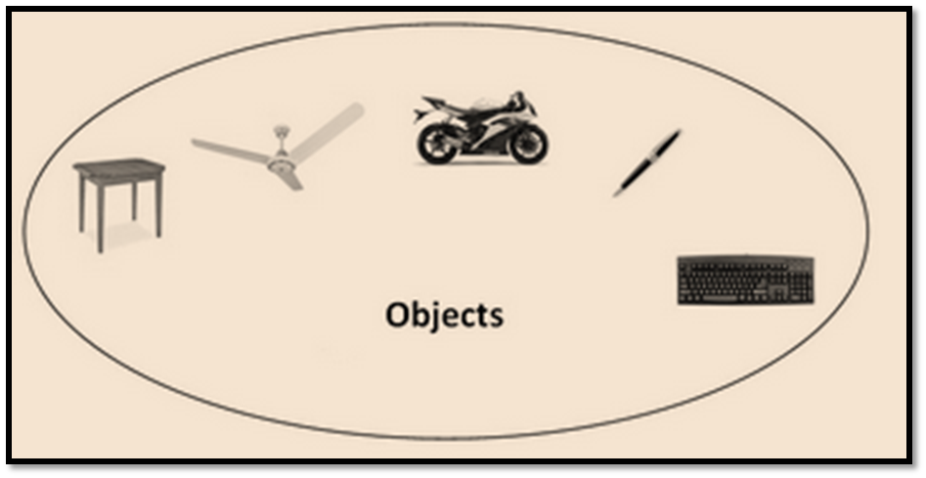
Object in Java
For Example: Pen is an object.
  Its name is Reynolds,
  color is white etc. known as its state.
  It is used to write, so writing is its behavior.

Slide 5
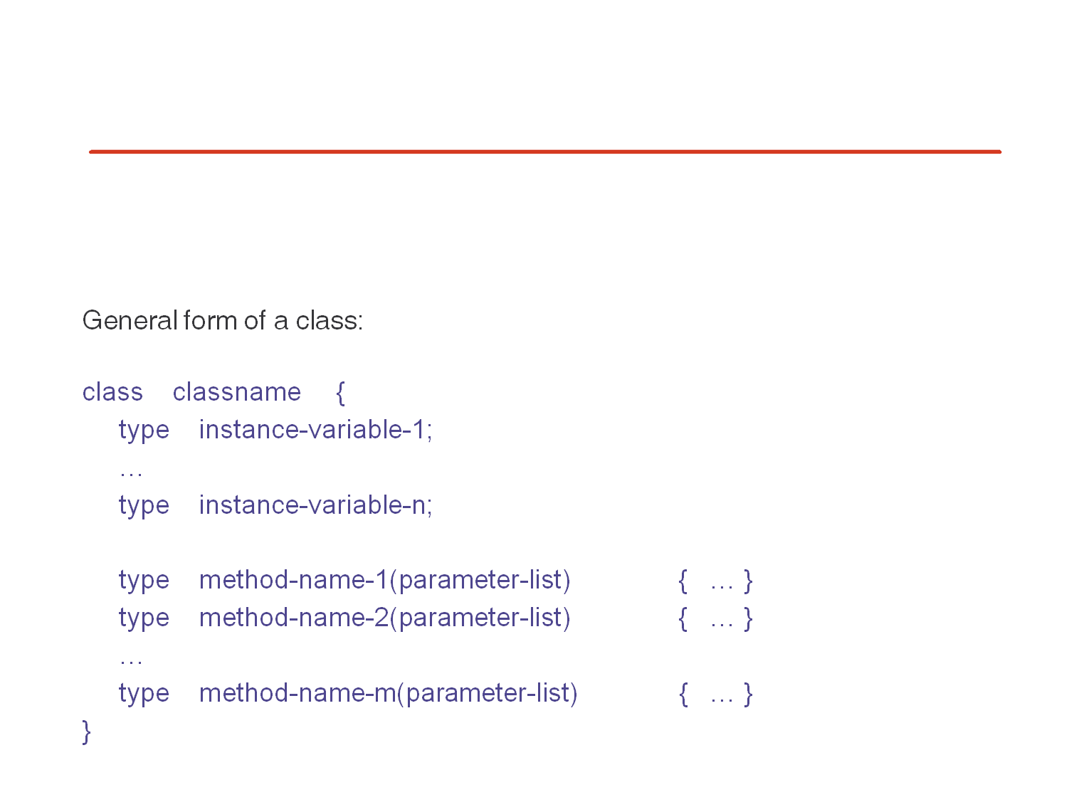
General form to declare a class

Slide 6
Example of Class and Object
class Student_Info
{
int id;//data member
String name;//data member
public static void main(String args[])
{
Student_Info s = new Student_Info();
System.out.println(s.id);
System.out.println(s.name);
}
}
Output:
0
null

Slide 7
Object Creation
There are three steps when creating an object from a class −
  Declaration − A variable declaration with a variable name with an object type.
  Instantiation − The 'new' keyword is used to create the object.
  Initialization − The 'new' keyword is followed by a call to a constructor. This call initializes the new object.

Slide 8
Example…
class Student_Info
{
int id;//data member
String name;//data member
public static void main(String args[])
{
Student_Info s = new Student_Info();
s.id = 1;
s.name = “ABC”
System.out.println(“ID:”+s.id);
System.out.println(“Name:”+s.name);
}
}
Output:
ID:1
Name: ABC

Slide 9
new Keyword
Indicates that it does not point to any object
null
s
Student s;
s = new Student( );
s.id
s
combined
s.name
Student s = new Student();

Slide 10
Methods in Java
In java, a method is like function i.e. used to expose behavior of an object.
Advantage of Method
  Code Reusability
  Code Optimization

Slide 11
Simple method…
class Bank
{
double p, r;
int n;
double simpleInterest()
{
return(p*r*n/100);
}
}
class Bank_Demo
{
public static void main(String[] args)
{
Bank b1 = new Bank();
b1.p = 5000; b1.r = 12; b1.n = 5;
double si = b1.simpleInterest();
System.out.println(“Simple interest is:”+ si);
}
}

Slide 12
Parameterized method
class Bank
{
double p, r;
int n;
void setData(double pa, double ra, int ny)
{ p = pa; r = ra; n = ny; }
double simpleInterest()
{
return(p*r*n/100);
}
}
class Bank_Demo
{
public static void main(String[] args)
{ Bank b1 = new Bank();
Bank b2 = new Bank();
b1.setData(5000,12 ,5);
b2.setData(10000,12 ,5);
double si = b1.simpleInterest();
System.out.println(“Simple interest is:”+ si);
System.out.println(“Simple interest is:”+
b2. simpleInterest());
}
}

Slide 13
Method Overloading
If a class has multiple methods having same name but different Signature (parameters) known as Method Overloading.
Different ways to overload the method
  By changing number of arguments
  By changing the data type

Slide 14
By changing the no. of arguments
class Calculation
{
void sum(int a,int b)
{
System.out.println(a+b);
}
void sum(int a,int b,int c)
{
System.out.println(a+b+c);}
}
class CalDemo
{
public static void main(String args[])
{
Calculation c=new Calculation();
c.sum(10,10,10);
c.sum(20,20);
}
}

Slide 15
By changing data type….
class Calculation
{
void sum(int a,int b)
{
System.out.println(a+b);
}
void sum(double a, double b)
{
System.out.println(a+b);
}
void sum(float a, float b)
{
System.out.println(a+b);
}
}
class CalDemo
{ public static void main(String args[])
{
Calculation c=new Calculation();
c.sum(10,20);
c.sum(20.5,30.5);
c.sum(10.5f,20.6);
}
}

Slide 16
Constructor in Java
Constructor in java is a special type of method that is used to initialize the object.
Constructor is invoked at the time of object creation.
It constructs the values(provides data) for the object that is why it is known as constructor.
Rules for creating java constructor
  Constructor name must be same as its class name
  Constructor must have no explicit return type
Types of java constructors
  Default constructor (no-argument constructor)
  Parameterized constructor

Slide 17
Java Default Constructor
A constructor that have no parameter is known as default constructor.
Default constructor provides the default values to the object like 0, null etc. depending on the type.
Syntax of default constructor:
    <class_name>()
    {
    ------------
    }
Rule: If there is no constructor in a class, compiler automatically creates a default constructor.

Slide 18
Example…
class Bank
{
double p, r;
int n;
Bank()
{
p = 5000; r = 12; n = 5;
}
double simpleInterest()
{
return(p*r*n/100);
}
}
class Bank_Demo
{
public static void main(String[] args)
{ Bank b1 = new Bank();
Bank b2 = new Bank();
double si = b1.simpleInterest();
System.out.println(“Simple interest is:”+ si);
si= b2. simpleInterest();
System.out.println(“Simple interest is:”+ si);
}
}

Slide 19
Parameterized Constructor
class Bank
{
double p,r;
int n;
Bank(double pa, double ra, int ny)
{
p = pa; r = ra; n = ny;
}
double simpleInterest()
{
return(p*r*n/100);
}
}
class Bank_Demo
{
public static void main(String[] args)
{ Bank b1 = new Bank(5000,12,5);
Bank b2 = new Bank(1000,12,4);
double si = b1.simpleInterest();
System.out.println(“Simple interest is:”+ si);
si= b2. simpleInterest();
System.out.println(“Simple interest is:”+ si);
}
}

Slide 20
Can’t Do…Compilation Error
class Student
{ int id; String name;
Student(int i,String n) { id = I; name = n; }
void display(){System.out.println(id+" "+name);}
public static void main(String args[])
{ Student s1 = new Student(111,"Karan");
Student s2 = new Student(222,"Aryan");
Student s3 = new Student(); X
s1.display();
s2.display();
s3.display();
}
}

Slide 21
Constructor Overloading in Java
class Student
{
int id, age;
String name;
Student( )
{
id = 0; name = ” ”; age=0
}
Student(int i, String n)
{
id = i; name = n; age=18;
}
Student(int i, String n, int a)
{
id = i;
name = n;
age=a;
}
void display()
{
System.out.println(id+" "+name+" "+age);
}
public static void main(String args[])
{
Student s1 = new Student(1,“XYZ");
Student s2 = new Student(2,"ABC",25);
Student s3 = new Student();
s1.display();
s2.display();
s3.display();
}
}

Slide 22
Copy Constructor
class Bank
{ double p,r;
int n;
Bank() //default constructor
{
p = 1000; r = 10; n = 5;
}
Bank(double pa, double ra, int ny) //Parameterized construtor
{
p = pa; r = ra; n = ny;
}
Bank(Bank b) // copy constructor
{
p = b.p; r = b.r; n = b.n;
}
double simpleInterest()
{
return(p*r*n/100);
}
}
class Bank_Demo
{ public static void main(String[] args)
{ Bank b1 = new Bank();
Bank b2 = new Bank(1000,12,4);
Bank b3 = new Bank(b2);
Bank b4 = b1;
double si = b1.simpleInterest();
System.out.println(“Simple interest is:”+ si);
si= b2. simpleInterest();
System.out.println(“Simple interest is:”+ si);
si= b3. simpleInterest();
System.out.println(“Simple interest is:”+ si);
si= b4. simpleInterest();
System.out.println(“Simple interest is:”+ si);
}
}

Slide 23
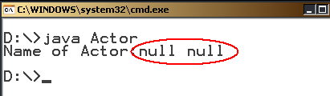
Use of this keyword
this is a keyword in Java. Which can be used inside method or constructor of class.
It(this) works as a reference to current object whose method or constructor is being invoked.
Example…(without this)
class Actor
{
String lastname;
String firstname;
Actor(String lastname, String firstname)
{
lastname = lastname;
firstname = firstname;
}
public static void main(String args[])
{
Actor a = new Actor("Devgan","Ajay");
System.out.println("Name of Actor:"+a.firstname
+" "+a.lastname);
}
}

Slide 24
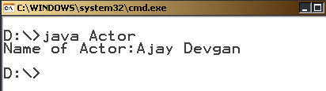
Example…(with this keyword)
class Actor
{
String lastname;
String firstname;
Actor(String lastname, String firstname)
{
this.lastname = lastname;
this.firstname = firstname;
}
public static void main(String args[])
{
Actor a = new Actor("Devgan","Ajay");
System.out.println("Name of Actor:"+a.firstname
+" "+a.lastname);
}
}

Slide 25
Difference between constructor and method
Java Constructor | Java Method
Constructor is used to initialize the state of an object. | Method is used to expose behavior of an object.
Constructor must not have return type. | Method must have return type.
Constructor is invoked implicitly. | Method is invoked explicitly.
The java compiler provides a default constructor if you don't have any constructor. | Method is not provided by compiler in any case.
Constructor name must be same as the class name. | Method name may or may not be same as class name.

Slide 26
Instance Variable
A variable that is created inside the class but outside the method, is known as instance variable.
Instance variable doesn't get memory at compile time.
It gets memory at runtime when object or instance is created.
That is why, it is known as instance variable.

Slide 27
Static Keyword
The static keyword in java is used for memory management mainly.
A variable or method which is declared with static keyword also known as Class variable or Class method because there is no need of object (instance) to use these.
The static can be:
  variable (also known as class variable)
  method (also known as class method)
  block
  nested class
If any variable declared as static, it is known static variable.
The static variable can be used to refer the common property of all objects (that is not unique for each object) e.g. company name of employees, college name of students etc.
The static variable gets memory only once in class area at the time of class loading.

Slide 28
Ex. of Counter without static
class Counter_Demo
{
int count=0;// will get memory when instance is created
Counter_Demo()
{
count++;
System.out.println(count);
}
public static void main(String args[])
{
Counter_Demo c1=new Counter_Demo();
Counter_Demo c2=new Counter_Demo();
Counter_Demo c3=new Counter_Demo();
}
}
Output:
1
1
1

Slide 29
Ex. of Counter with static
class Counter_Demo
{
static int count=0;//memory only once and retain its value
Counter_Demo()
{ count++;
System.out.println(count);
}
public static void main(String args[])
{
Counter_Demo c1=new Counter_Demo();
Counter_Demo c2=new Counter_Demo();
Counter_Demo c3=new Counter_Demo();
}
}
Output:
1
2
3

Slide 30
Example of static variable
class Student
{
int rollno;
String name;
static String college =“Atmiya";
Student(int r,String n)
{
rollno = r; name = n;
}
void display ()
{
System.out.println(rollno+" "+name+" "+college);
}
public static void main(String args[])
{
Student s1 = new Student(10,”XYZ");
Student s2 = new Student(20,“ABC");
s1.display();
s2.display();
}
}

Slide 31
Java static method
If you apply static keyword with any method, it is known as static method.
A static method can be invoked without the creating an instance (object) of a class.
static method can access static data member and can change the value of it.
Note: Static method can not access instance members of class.

Slide 32
Example…
class Calculate
{
static int cube(int x)
{
return x*x*x;
}
}
class Demo
{
public static void main(String args[])
{
int result=Calculate.cube(5);
System.out.println(result);
result=Calculate.cube(10);
System.out.println(result);
}
}
Output:
125
1000

Slide 33
Static and non Static member
class A
{
int a=40;//non static
public static void main(String args[])
{
System.out.println(a);
}
}
=====
class A
{
static int a=40;//static
public static void main(String args[])
{
System.out.println(a);
}
}
Output:
Compile time error
Output:
40

Slide 34
Variable Argument (Varargs):
The varrags allows the method to accept zero or muliple arguments.
varargs is the better approach if we don't know how many argument we will have to pass in the method.
Syntax:
accessModifier methodName(datatype… arg)
{
// method body
}
Rules for varargs:
  There can be only one variable argument in the method.
  Variable argument (varargs) must be the last argument.
Examples of varargs that fails to compile:
void method(String... a, int... b){} //Compile time error
void method(int... a, String b){} //Compile time error

Slide 35
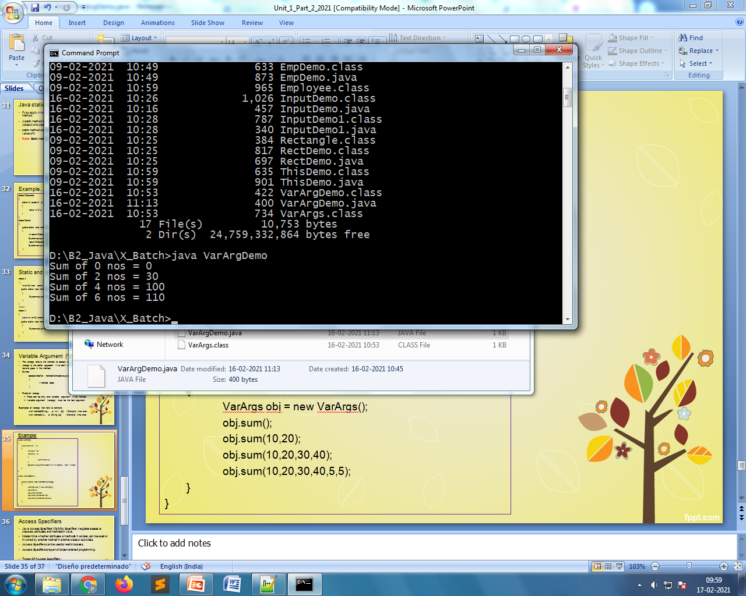
Example:
class VarArgs
{
void sum(int ... n)
{
int sum = 0;
for(int a : n)
{
sum=sum+a;
}
System.out.println("Sum of "+n.length+ " nos = "+sum);
}
}
class VarArgDemo
{
public static void main(String args[])
{
VarArgs obj = new VarArgs();
obj.sum();
obj.sum(10,20);
obj.sum(10,20,30,40);
obj.sum(10,20,30,40,5,5);
}
}

Slide 36
Access Specifiers
Java Access Specifiers (Visibility Specifiers ) regulate access to classes, attributes and methods in Java.
It determine whether attributes or methods in a class, can be used or invoked by another method in another class or sub-class.
Access Specifiers can be used to restrict access.
Access Specifiers are part of object-oriented programming.
Types Of Access Specifiers :
1. public
2. private
3. protected
4. default(no specifier)

Slide 37
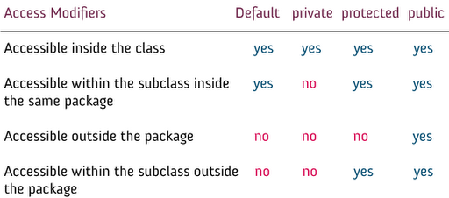
Access Specifiers…

